Slide 1
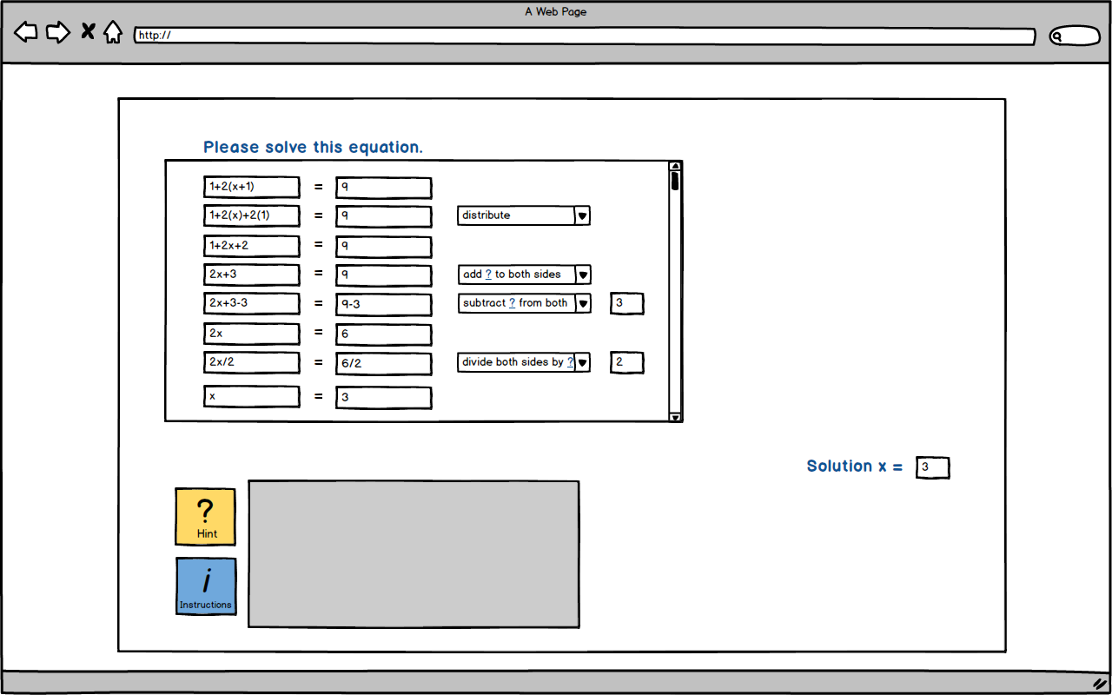
Browser background and UI
CODE: BROWSER

Slide 2
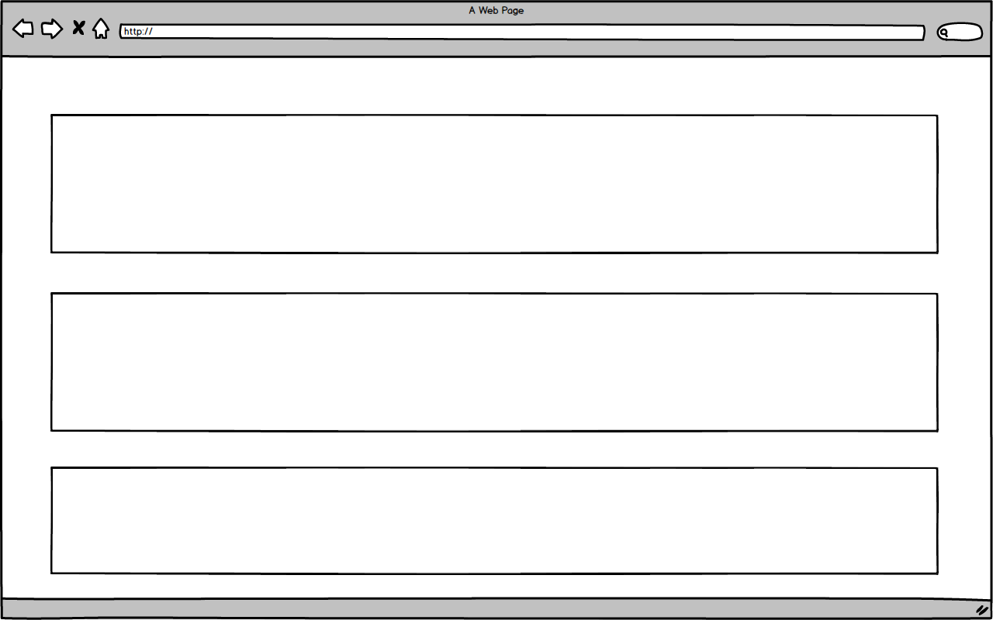
Browser tutor zoomed
CODE: ZoomBrow

Slide 3
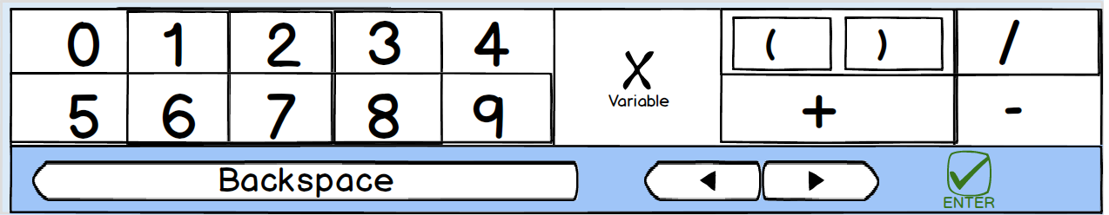
full-width keyboard
CODE: noxLONG

Slide 4
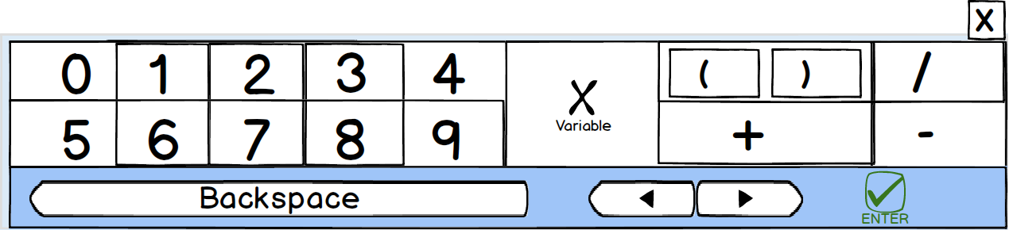
full-width keyboard
CODE: xLONG

Slide 5
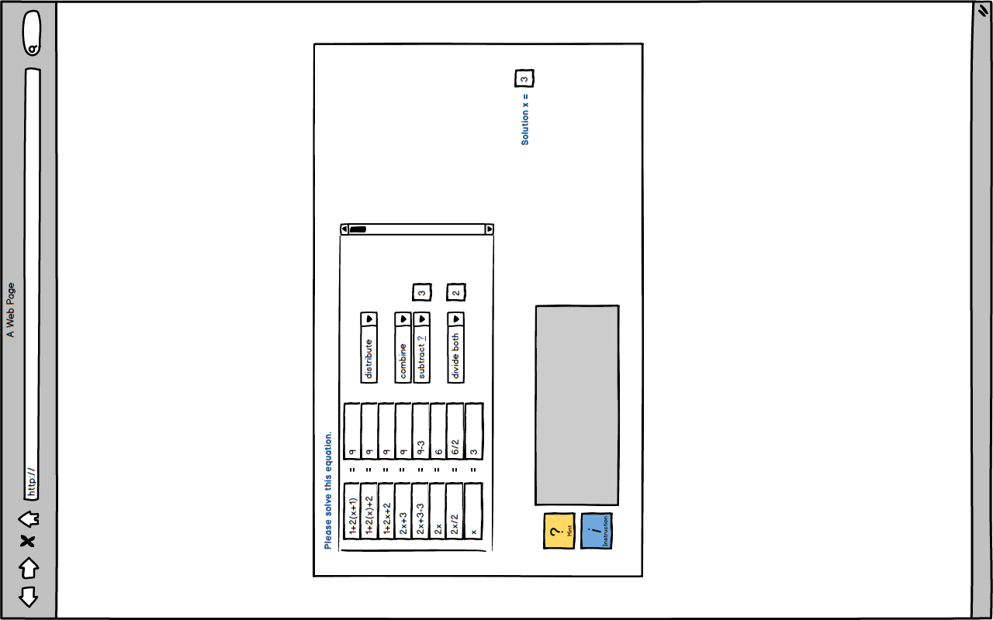
Browser portrait view
CODE: PORTRAIT

Slide 6
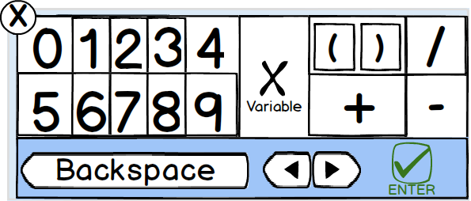
Compact keyboard
CODE: xLANDSCAPE

Slide 7
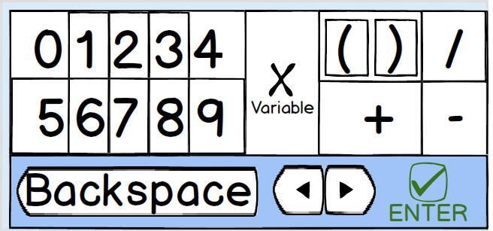
Compact keyboard
CODE: noxLANDSCAPE

Slide 8
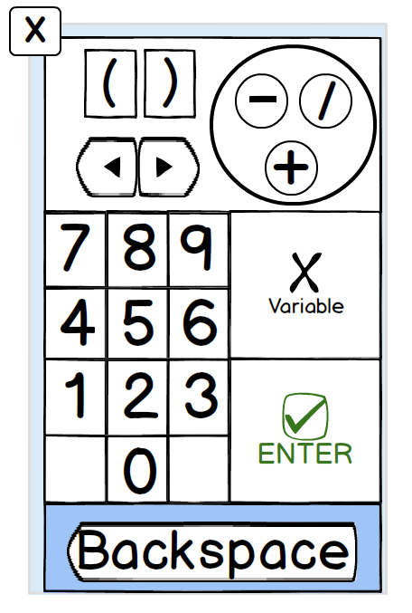
Numpad style keyboard
CODE: NUMBOT

Slide 9
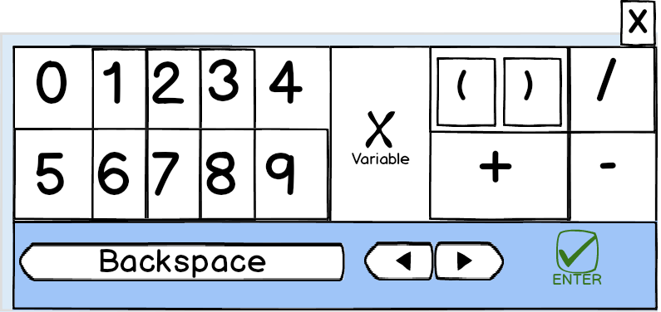
Portrait keyboard
CODE: xPORTRAIT

Slide 10
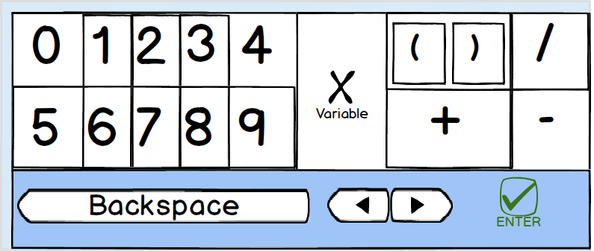
Portrait keyboard
CODE: noxPORTRAIT

Slide 11
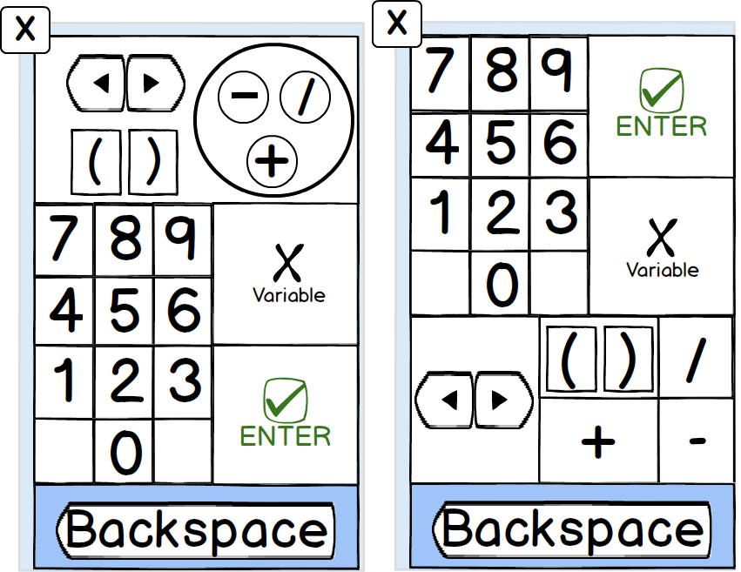
Numpad style keyboard
CODE: NUMTOP

